Slide 1





UNLEASH THE CODER INSIDE YOU
PET VERSE
TEAM NAME –ONE FOR ALL

Slide 2
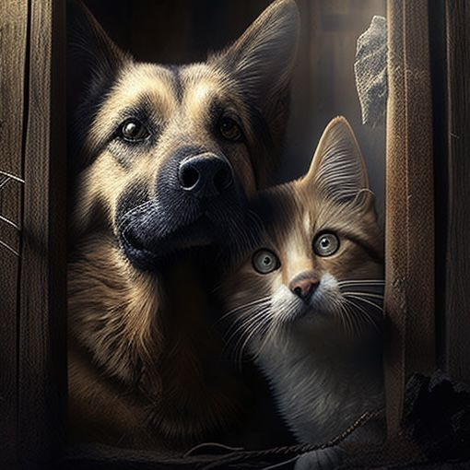
UNLEASH THE CODER INSIDE YOU
PROBLEM STATEMENT DETAILS
Many people yearn for the companionship of pets but face practical limitations like allergies, small living spaces, or busy schedules that make traditional pet ownership challenging. While virtual pet apps exist, they often lack depth and realistic interaction, leaving users unsatisfied. Additionally, technologies such as Augmented Reality (AR) and Virtual Reality (VR) that could create a more immersive experience are largely untapped in this space. As a result, people seeking an engaging and emotionally rewarding pet interaction are left with few suitable options.

Slide 3
UNLEASH THE CODER INSIDE YOU
PROPOSED SOLUTION
An innovative virtual pet adoption platform that provides an immersive, lifelike pet ownership experience.
•Key Components:
•Augmented Reality (AR): Integrate virtual pets into real-world settings.
•Virtual Reality (VR): Experience pet care in fully immersive virtual environments.
•Gamification: Engage users with rewards, achievements, and interactive pet care tasks.

Slide 4
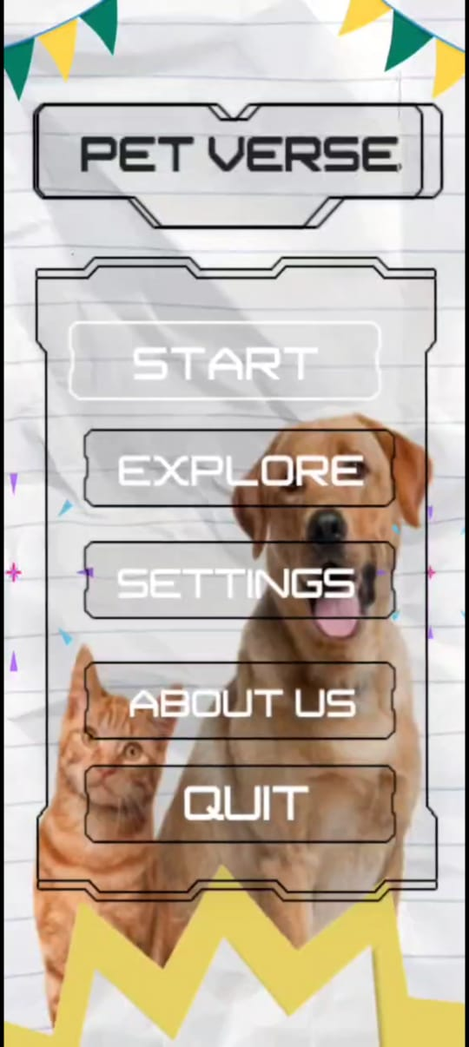
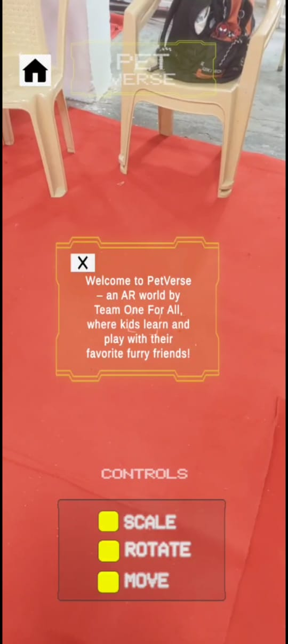
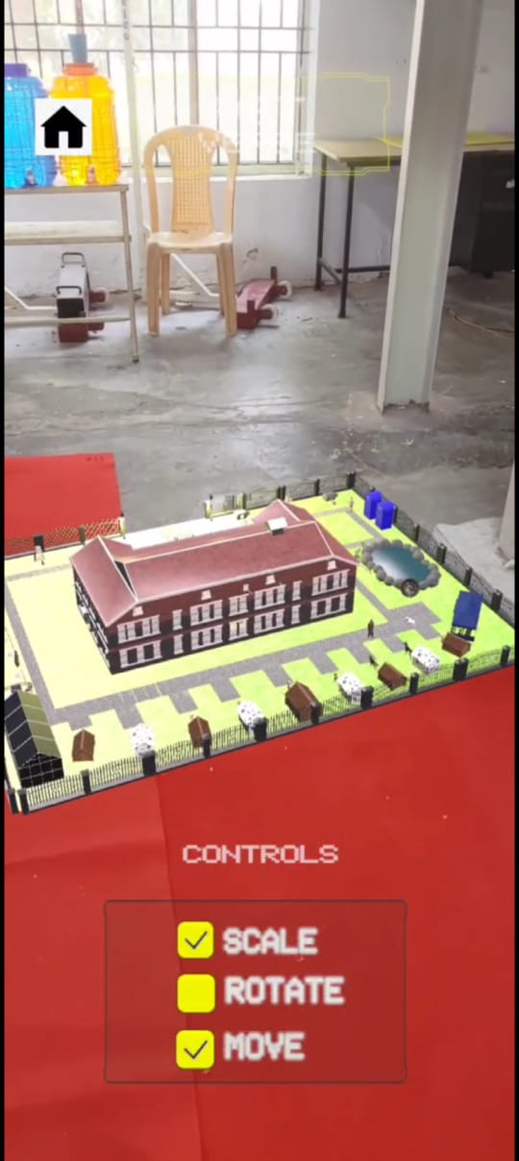
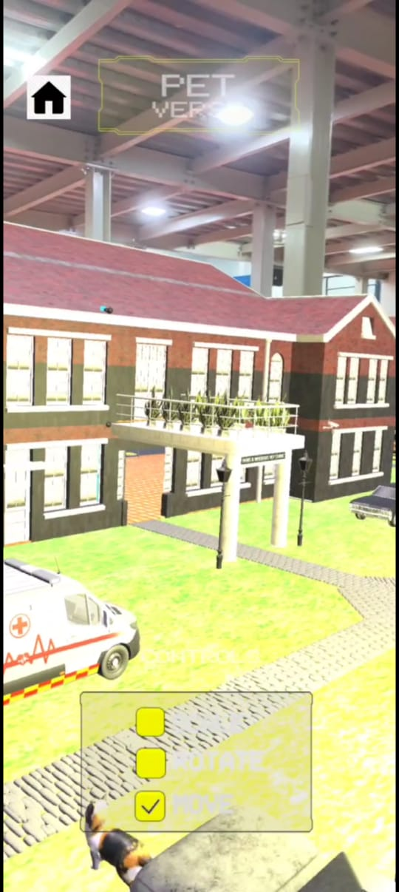
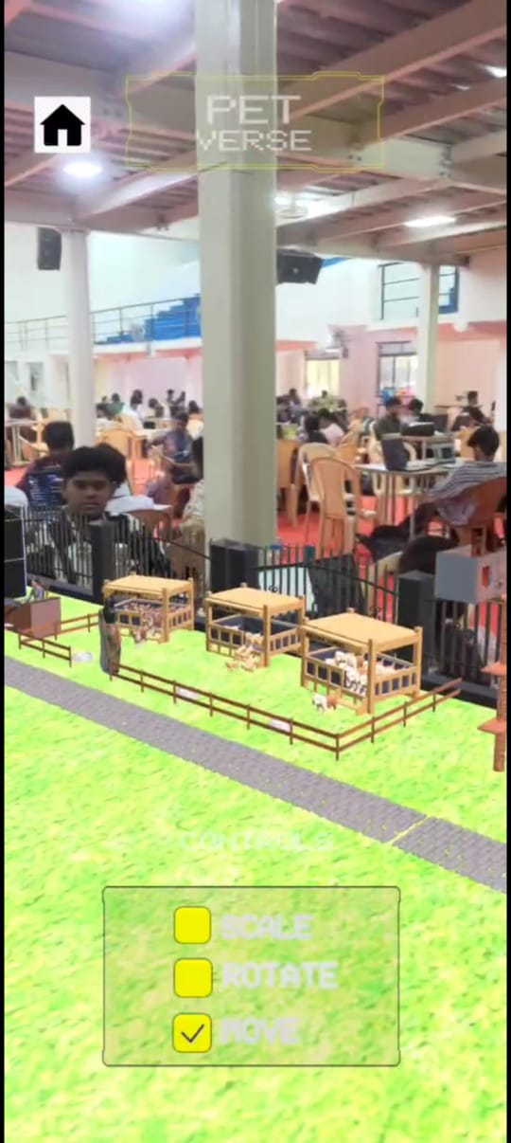
UNLEASH THE CODER INSIDE YOU
- ARGUMENTED REALITY
ARCHITECTURE DESIGN

Slide 5
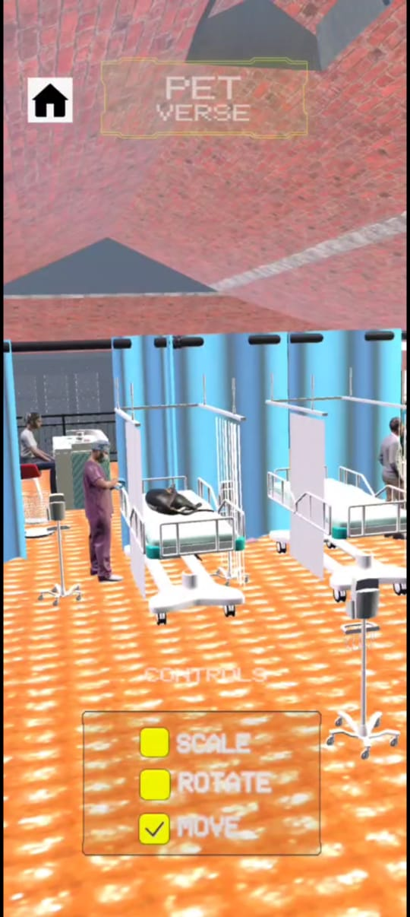
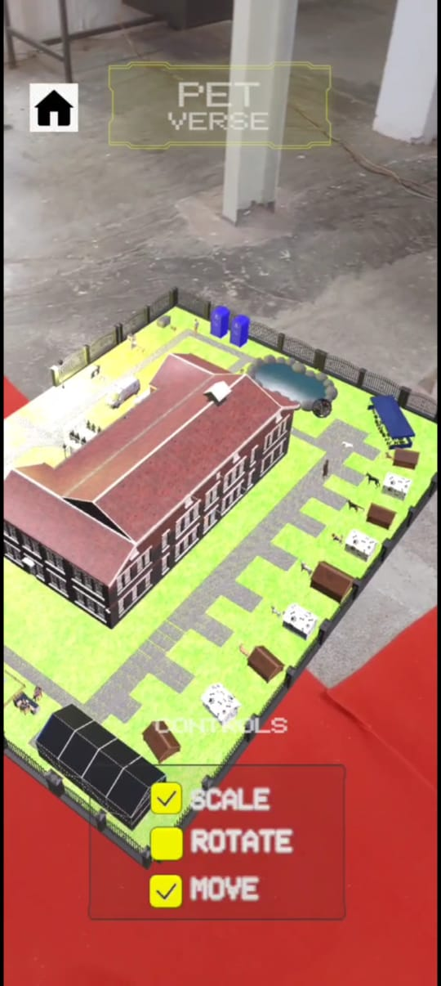
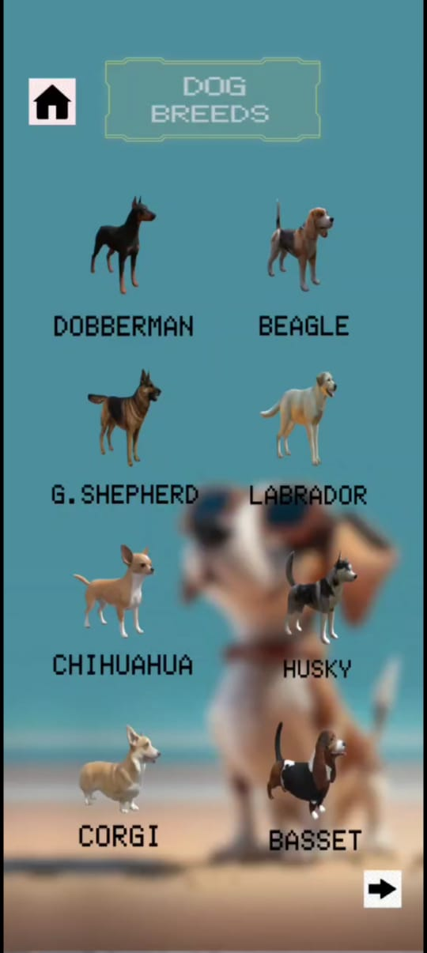
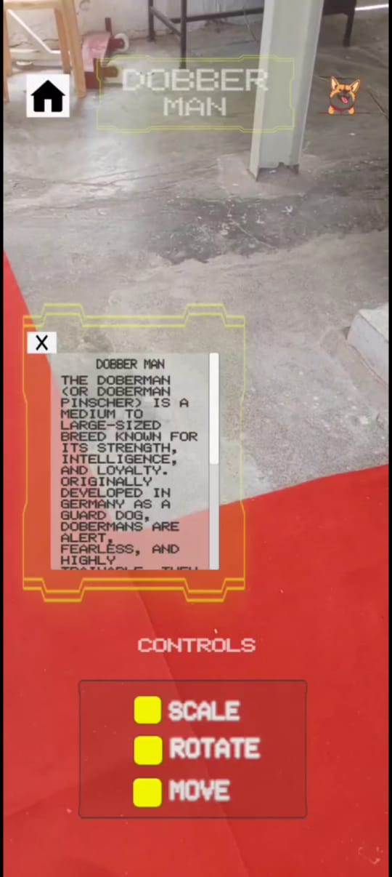
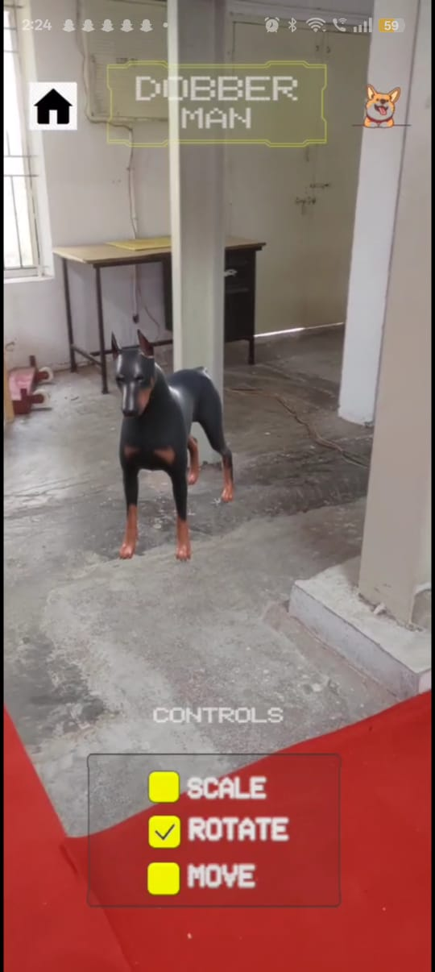
UNLEASH THE CODER INSIDE YOU

Slide 6
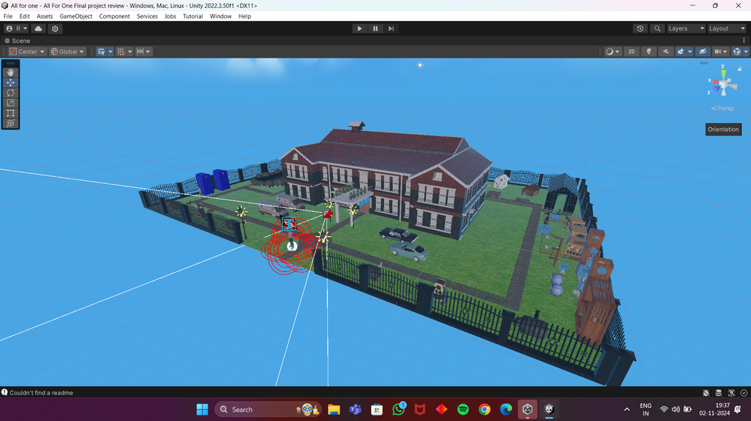
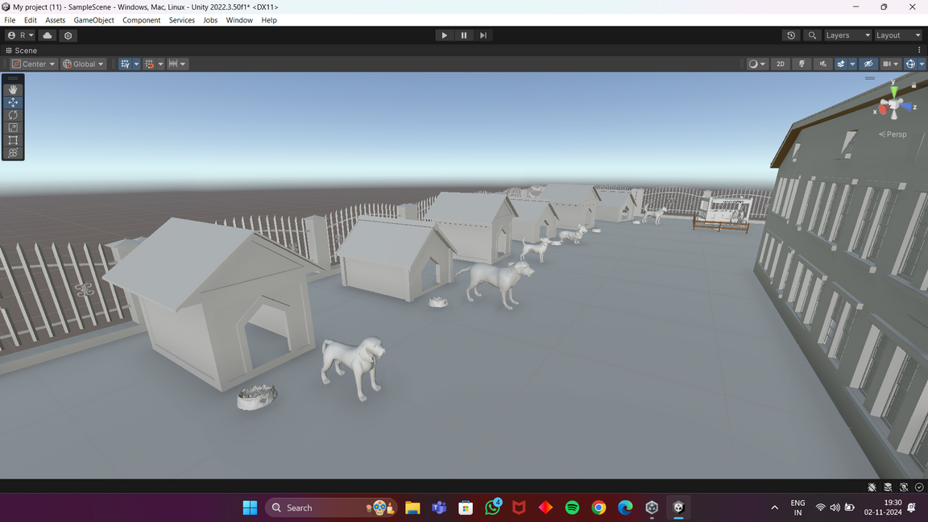
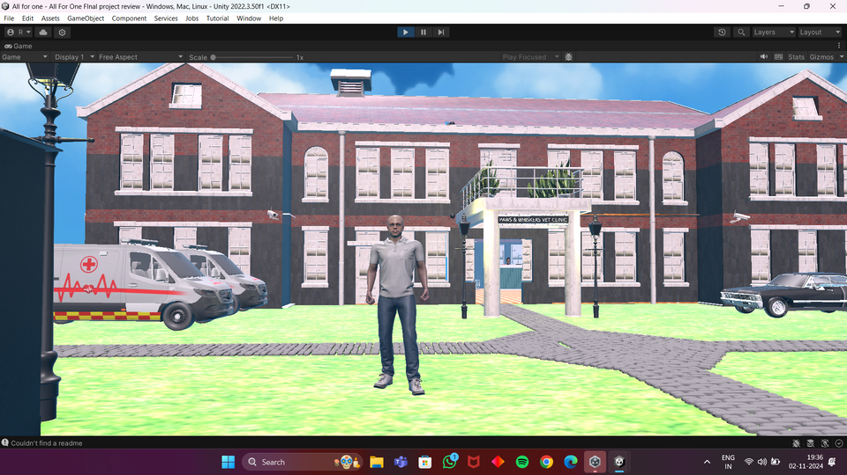
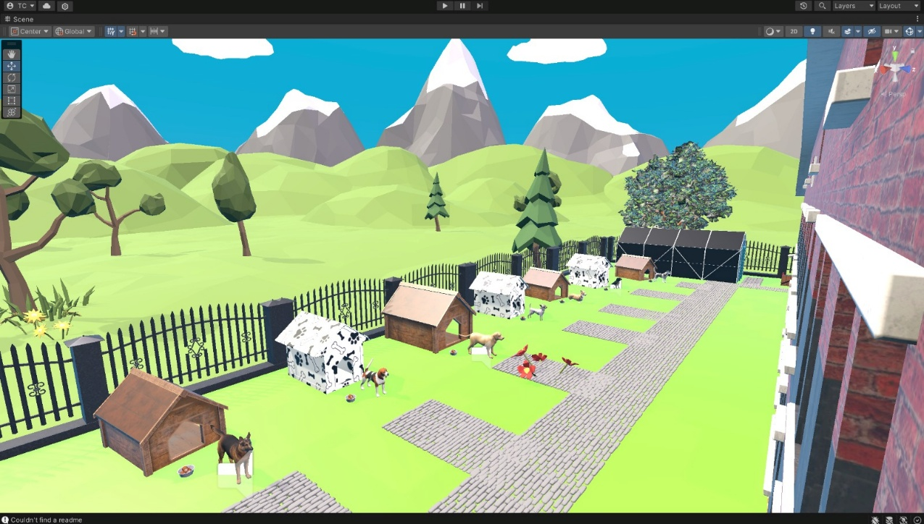
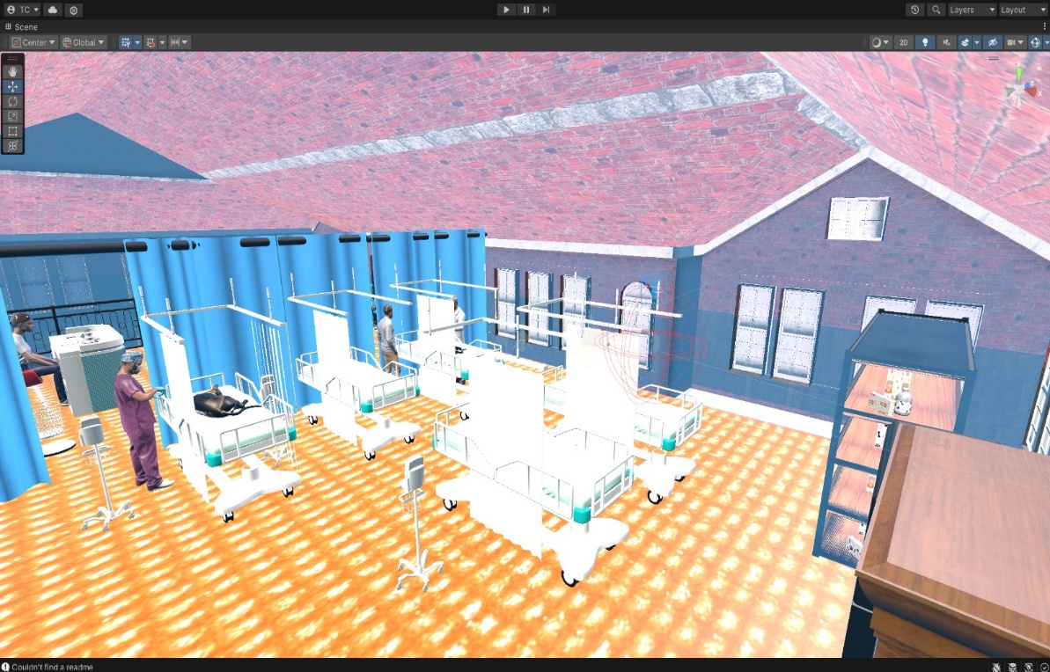

UNLEASH THE CODER INSIDE YOU
VIRTUAL REALITY & GAMEFIED VERSION

Slide 7
UNLEASH THE CODER INSIDE YOU
UNIQUENESS OF THE SOLUTION
All-in-One Pet Ecosystem
Combines pet care tips, training guides, health tracking, feeding schedules, and more — all in one place.
Community-Driven & Breed-Specific
Offers personalized content for different breeds (like Doberman, Beagle, Husky, etc.) and lets users share experiences, tips, and photos.
Focus on Pet Wellness & Bonding
Goes beyond care — encourages emotional bonding, mental stimulation, and ethical pet ownership through expert advice and fun activities.

Slide 8




UNLEASH THE CODER INSIDE YOU
TECH STACK
Platform Components:
•AR Module: Mobile-friendly interface for real-world pet interactions.
•VR Environment: Immersive spaces for VR headset users.
•Game Engine: Unity to support interactive pet experiences.
Backend:
•C# for the pop ups which deliver information of the pet.

Slide 9
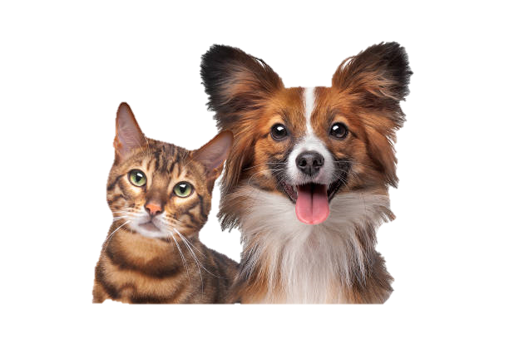
UNLEASH THE CODER INSIDE YOU
FUTURE SCOPE
AI-Driven Personalities:
•Develop AI-based pet personalities that adapt based on interactions and user preferences.
Expanded Community Features:
•Virtual playdates, competitions, and social features for a community-driven experience.
Real-World Integration:
•Collaboration with pet shelters or stores for users interested in real pet adoption.
Platform Expansion:
•Broaden platform compatibility to include consoles and newer VR devices.

Slide 10




UNLEASH THE CODER INSIDE YOU
TEAM MEMBER DETAILS
RISHI R L
SWATHY C
RITHIKA H
RAHUL S

Slide 11
UNLEASH THE CODER INSIDE YOU
THAT'S A WRAP!

